Slide 1
Lambda Function in Python
Presenter: Yilin Pan, Xiaojing An, Weihang Ding

Slide 2
Introduction of Lambda
PART II

Slide 3
Lambda Function in Python
Lambda functions provide a concise way to create:
small, anonymous functions
without needing to define a formal function using def.

Slide 4
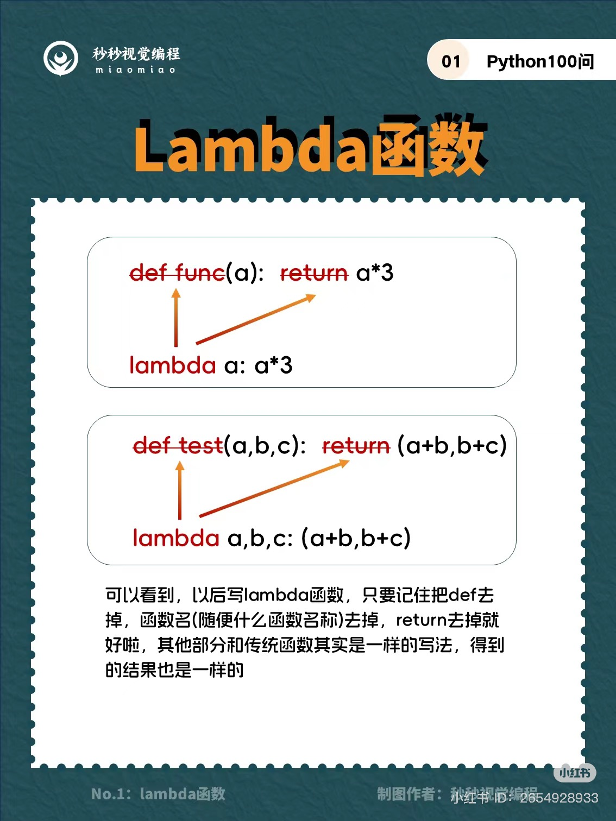
Syntax of Lambda Function in Python
the expression of lambda function is composed of:
The keyword: lambda
A bound variable: x
A body

Slide 5
Differences between lambda and def functions
Syntax:

Slide 6
Differences between lambda and def functions
Return:
Lambda functions implicitly return the result of evaluating the expression
def functions use an explicit return statement.
Scope:
Lambda functions are limited to a single expression.
Def functions can contain multiple statements and have more complex logic.

Slide 7
Lambda Function in Python
handy
anonymous
needed for a short period

Slide 8
Example of usage: Gradebook
PART III

Slide 9
Be careful! When to use and when not to use
PART VI

Slide 10
The advantage of using Lambda function
handy
anonymous
needed for a short period

Slide 11
The downside of using Lambda function
Limited Readability
Can’t Handle Complex Logic
Difficult to Debug
Reusability Issues

Slide 12
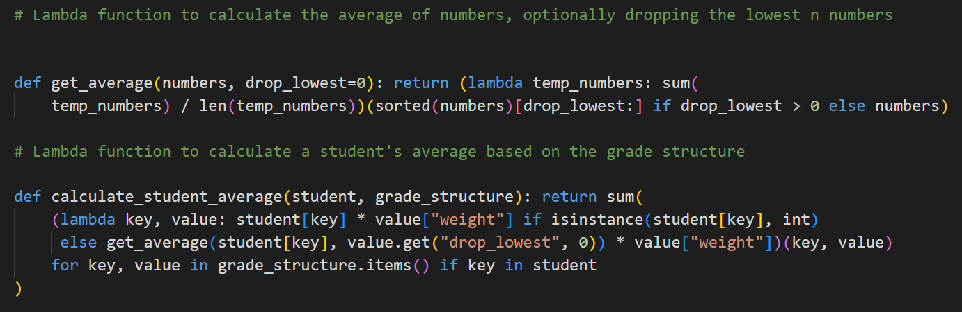
Example of limited readability

